Slide 1
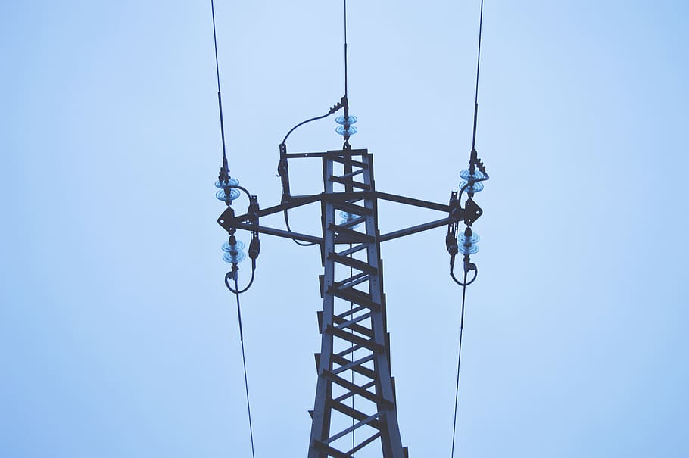

SPAIN ELECTRICITY PROJECT 2022

Slide 2

Introduction to the Session
Team Check- In
TODAY’S
AGENDA
The Project Journey
Summary & Action Items

Slide 3




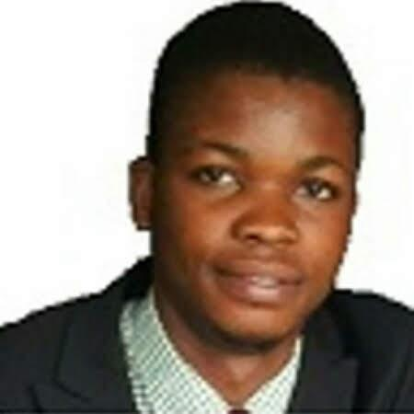

Meet The Team
Joshua Olalemi
CEO
Silindile Mbamali
CFO
Adewale Nana
CTO
Peter Otanwa
CPO
Ubong Ben
CPO
Daniel Ifediba
CPO

Slide 4

Are You
Ready
Let’s Begin!

Slide 5
The Project Journey
PROBLEM STATEMENT
EDA PROCESS
MODEL BUILDING
SUMMARY OF FINDINGS
MODEL DEPLOYMENT

Slide 6
Problem Statement
In this project, NM3 Energies were tasked to model the shortfall between the energy generated by means of fossil fuels and various renewable sources - for the country of Spain.
We used machine learning and several regression techniques to make predictions for the government of Spain, who is considering an expansion of it's renewable energy resource infrastructure investments and they require information on the trends and patterns of the country's renewable sources and fossil fuel energy generation.

Slide 7

Understand The Data
We first tried to have an understanding of the data we were given, by the spanish government, and we found it to be inconsistent.
This got us stuck in the waters, so we knew the data had to be cleaned, re-structured and properly analysed

Slide 8

The EDA Process
Summary Statistics
Skew & Kurtosis Analysis
Graphical Analysis
Correlation Heatmap

Slide 9
Summary Statistics & Info
Basic Information
We found there to be missing information in the Valencia_pressure column in the dataset.
The time column was in a string format which we had to convert to datetime to make it suitable for out process.
Other features were converted to floats(numerical values) for the regression process.
Summary Statistics
We had to take an in-depth view of our dataset by performing what we call a descriptive stat for each feature,i.e; the mean, median, 1st quartile, 3rd quartile, the maximum and minimum values of each feature.
This gave us more information and insight about the dataset.

Slide 10
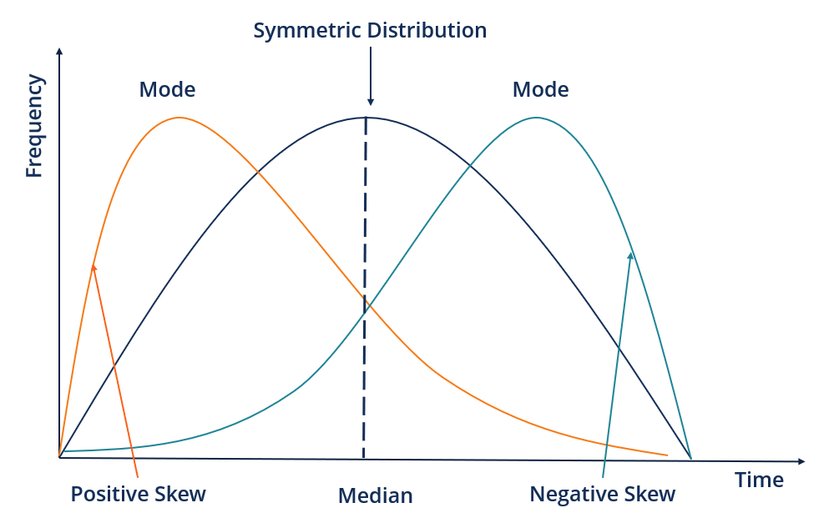
Skew Analysis

Slide 11
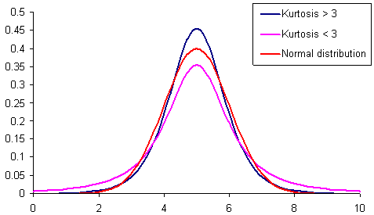
Kurtosis Analysis

Slide 12
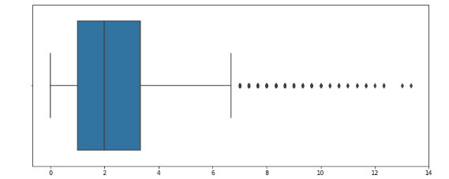
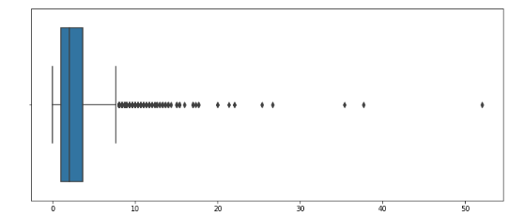
Graphical analysis: Boxplots For Madrid_wind_speed & Valencia_pressure
Madrid_wind_speed
Valencia_pressure

Slide 13
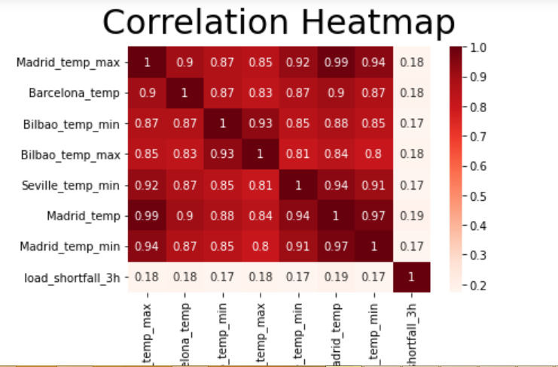

Slide 14

The Model Building
Objectives Of The Model Building Process
Models Used & The Effect On Our Test Data
Model Chosen
Reason For Choice

Slide 15
Objective Of The Model Building Process
●The aim of our model building is to look for a model that gives us the lowest possible error on our test sets.
●A low RMSE value indicates that the simulated and observed data are close to each other showing a better accuracy. Thus, the lower the RMSE, the better the model performance
●R² closer to 1 indicates healthy model.

Slide 16
Models Used & It’s Effect - Based On The Test Sets
Linear Regression Model
We were able to achieve an RMSE of 4703.0905
Also an R-Squared value of 0.165910
Ridge Regression Model
We were able to achieve an RMSE of 4703.0885
Also an R-Squared value of 0.165363
Decision Tree Model
We were able to achieve an RMSE of 4460.1356
Also an R-Squared value of 0.2498
Random Forest Model
We were able to achieve an RMSE of 2850.4754
Also an R-Squared value of 0.693605

Slide 17
Models Used & It’s Effect - Based On The Test Sets
From the previous slide, we can see that we achieved the lowest RMSE using the Random Forest Model.
In this case, it’s safe to say that we can deploy the model on our dependent variable ‘Load_shortfall_3h’ to get the predicted values.
The scatter plot on this next slides confirms this, as the actual and predicted values
are wrapped around the error line (in red)

Slide 18
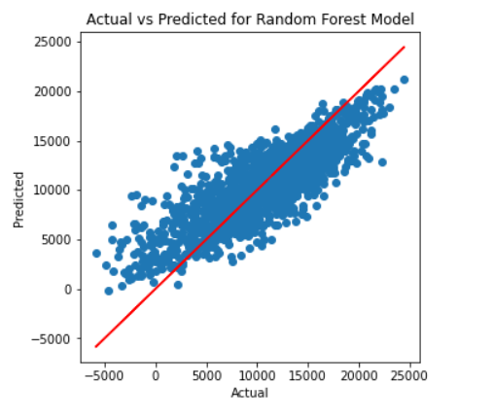

Slide 19
Summary
Spain government needs to understand shortfall between fossil fuel and renewable sources of energy.
EDA was conducted on the obtained data. Features were explored and scrutinized .
Redundant features were dropped. New features were engineered and added.
Random Forest model outperformed other regression models.

Slide 20
Recommendation
Spain government should adopt a dual energy deployment strategy.
Fossil fuel by day. Renewable energy by night.

